Slide 1
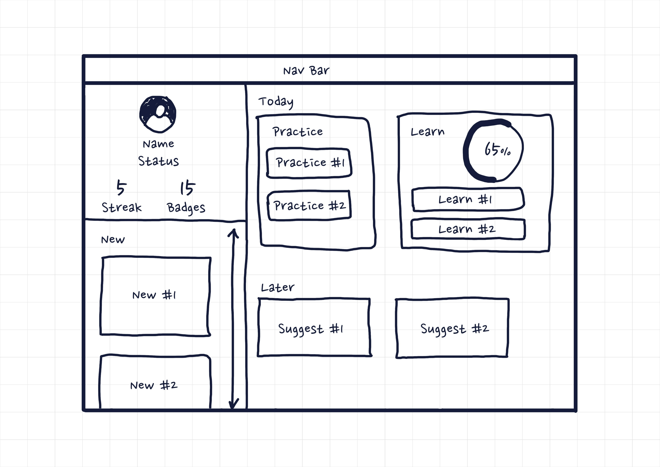
Dashboard Build
Practical

Slide 2
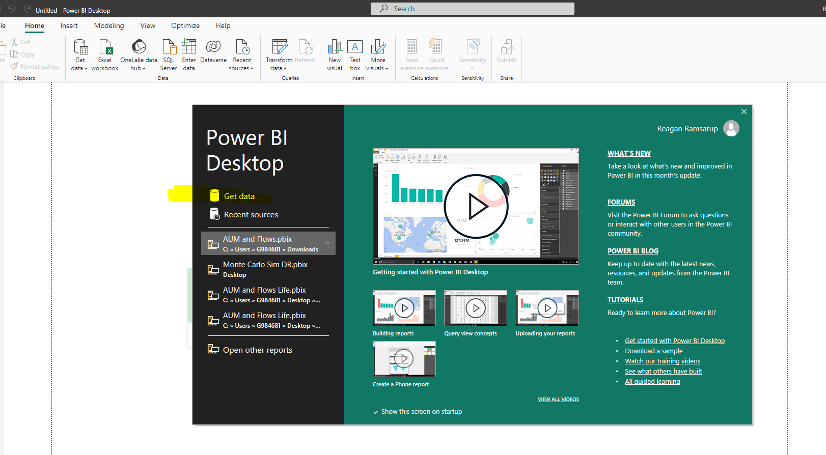
Connect to snowflake
When Power BI opens up, you are presented with this screen. Click Get data.

Slide 3
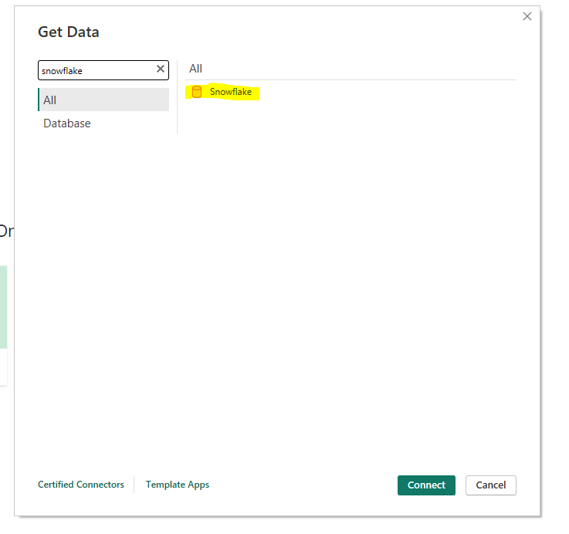
Connect to snowflake
Type in snowflake into the search box and the double click the highlighted

Slide 4
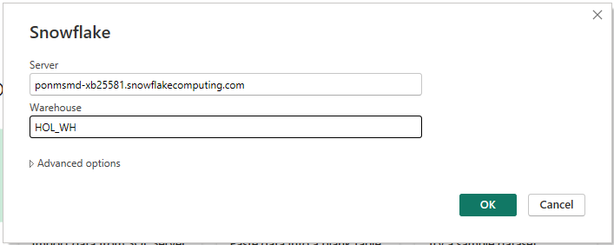
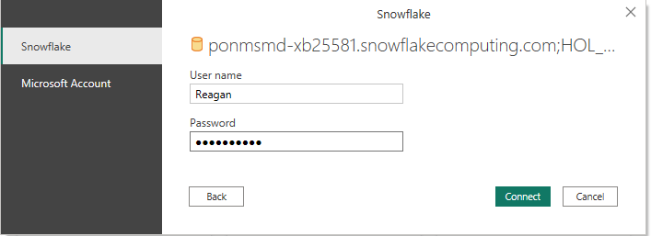
Connect to snowflake
Enter your account link from your email excluding the https:// and HOL_WH as the warehouse. Then hit ok.
Enter your snowflake username and password in the next popup and then connect

Slide 5
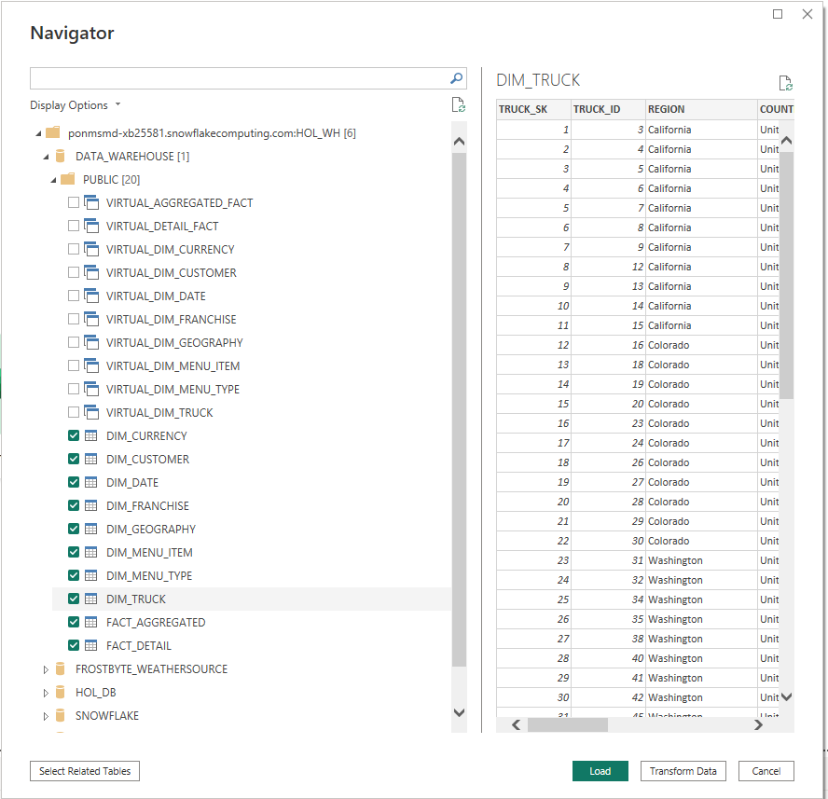
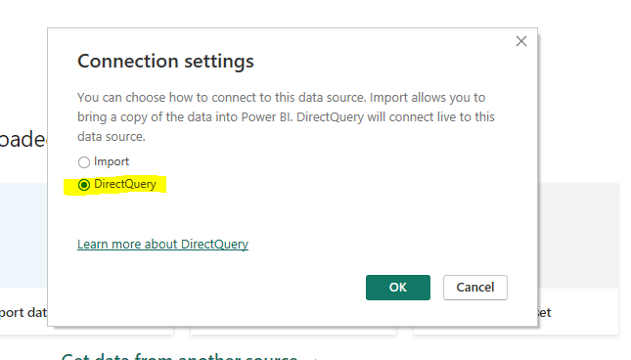
Choose your dataset
You can now select the dimensions and facts we build from the data warehouse database and bring them in to model. Then hit load. Use direct query.

Slide 6
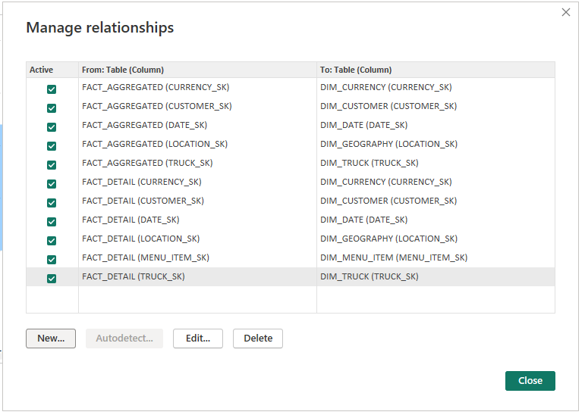
Model the data
Model all your relationships between the dimensions and facts. After you are done, you should end up with the list below.

Slide 7
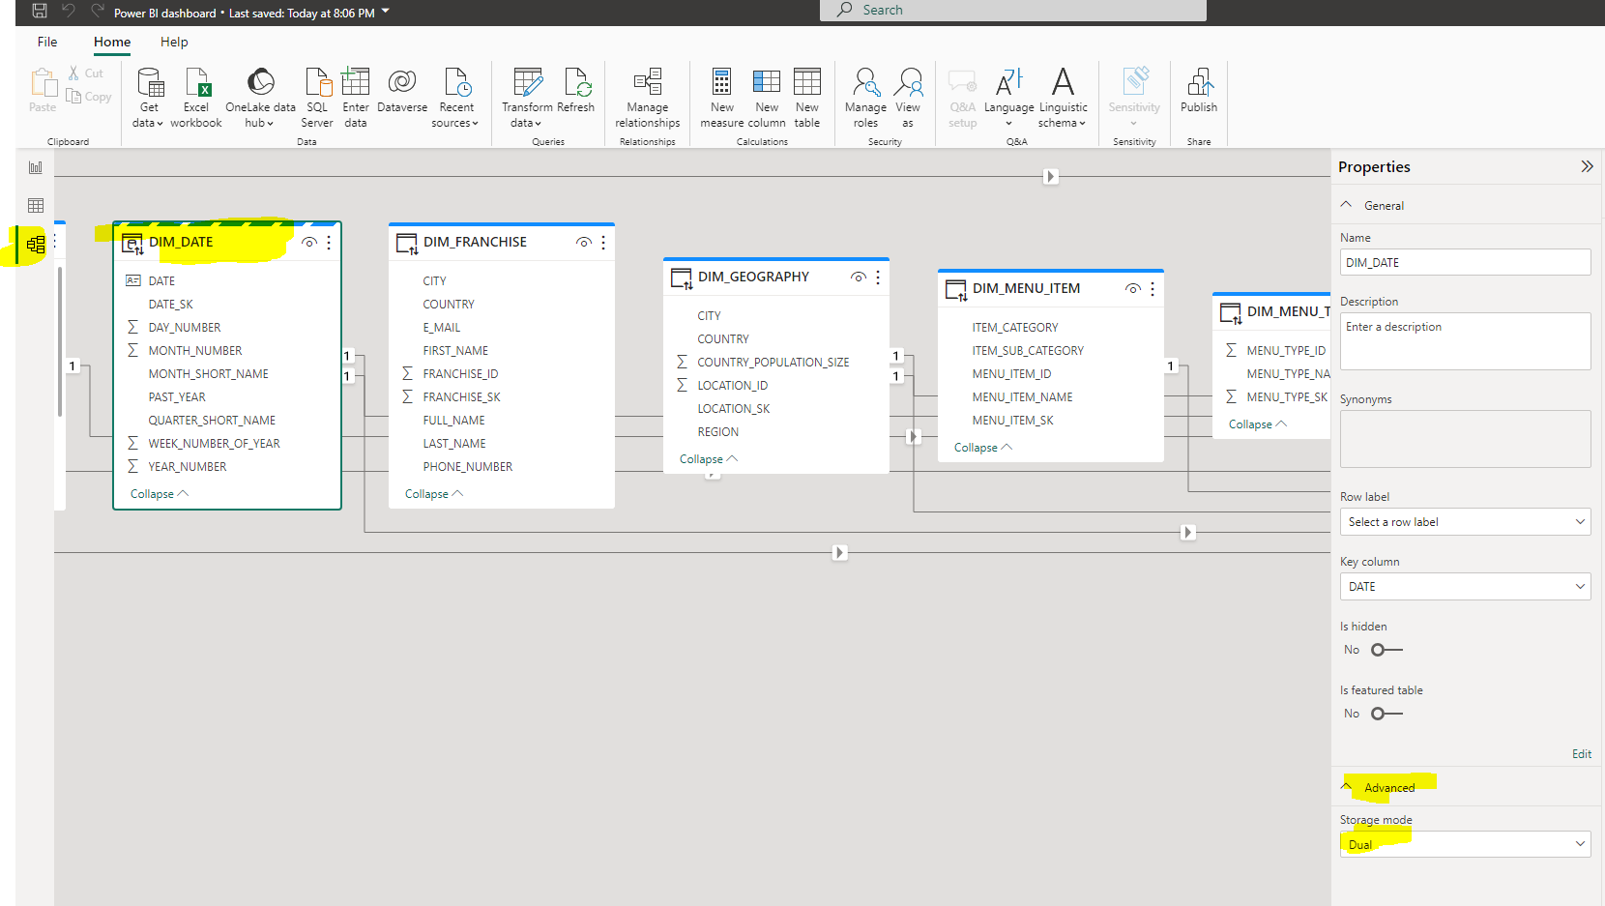
Model the data
We need to make one change to our table in order to do date specific measure calcs

Slide 8
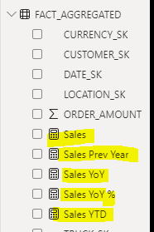
Creating measures
Lets create a few measures that we will be using in some of our visuals.
First create a sales measure that sums the amounts from the orders aggregated fact.
Then using that sales amount calculate the prior year sales value
Calculate a YTD value for sales
Calculate the year on year growth of sales (hint use the sales and prior year sales)
Calculate the year on year % growth.
Take 15 or so minutes to try and figure out how to create these measures, remember google is your friend.

Slide 9


Creating measures solution
Here are the solutions / code that can be used to create the measures from the previous slide.

Slide 10
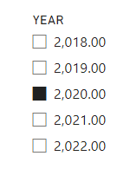
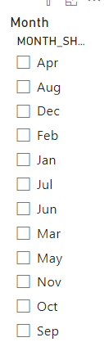
Lets create some filters on page one
Add a slicer for year and month, so the users can filter their data

Slide 11
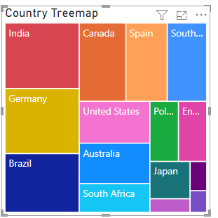
Lets add a tree map
Add a tree map to show sales per country, so we can see who are our biggest revenue generating countries are.

Slide 12
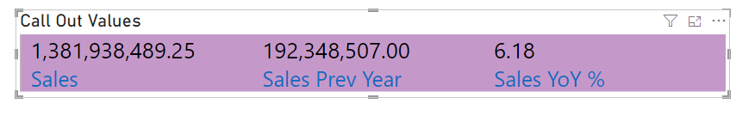
Lets add Some call out values
Add some call out values to give an overall summary of sales for the year. Try and figure out what visual is used in the image below and how to get yours looking similar

Slide 13
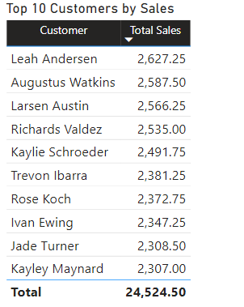
Top 10 customers by sales
Try and recreate the result below. This visual shows the top 10 customers by sales.

Slide 14
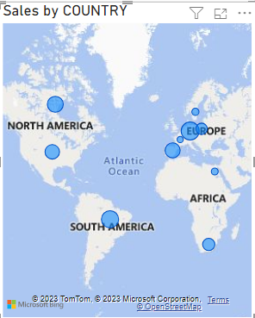
Creating the visuals
Add a visual to show the countries that shows spend size per country using a visual

Slide 15
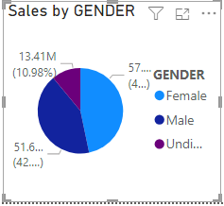
Creating the visuals
Create a visual that looks like the one below that shows sales per gender, ignore all unassigned genders.

Slide 16
Top 10 Customers measure
Lets create a top 10 customers measure so that we can look at top 10 customers by other stuff. See if you are able to find out how to create a top 10 customers measure.
And create a % sales measure using the top 10 customers measure

Slide 17
Top 10 Customers measure
If you were unsuccessful in creating the measures, here is the code.

Slide 18
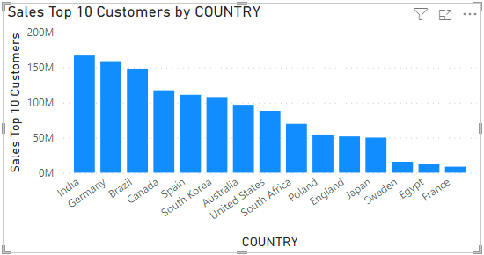
More visuals
Now that we have the top 10 customers measure, Lets make a few more visuals.
Create a top 10 customers by country bar graph

Slide 19
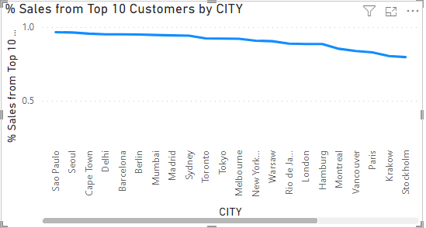
More visuals
Lets also add a line chat with top 10 customers by city

Slide 20

Creating the visuals
Find a way to get the word cloud visual. Create a word cloud with all the menu items, size the words by the amount spent on each product. Filter the menu to items that fall under the Hot Option sub category.

Slide 21
Questions?

